Slide 1
Software Testing & Quality
(04)-Source Code Coverage
陈振宇
南京大学软件学院
http://software.nju.edu.cn/zychen

Slide 2
Overview
The most common application of graph criteria is to program source
Graph : Usually the control flow graph (CFG)
Node coverage : Execute every statement
Edge coverage : Execute every branch
Loops : Looping structures such as for loops, while loops, etc.
Data flow coverage : Augment the CFG
  defs are statements that assign values to variables
  uses are statements that use variables

Slide 3
Control Flow Graphs
A CFG models all executions of a method by describing control structures
Nodes : Statements or sequences of statements (basic blocks)
Edges : Transfers of control
Basic Block : A sequence of statements such that if the first statement is executed, all statements will be (no branches)
CFGs are sometimes annotated with extra information
  branch predicates
  defs
  uses
Rules for translating statements into graphs …

Slide 4
CFG : The if Statement
if (x < y)
{
y = 0;
x = x + 1;
}
else
{
x = y;
}
1
x < y
x >= y
y = 0
x = x + 1
2
3
x = y
4
if (x < y)
{
y = 0;
x = x + 1;
}
1
x < y
y = 0
x = x + 1
2
x >= y
3

Slide 5
CFG : The if-Return Statement
if (x < y)
{
return;
}
print (x);
return;
1
x < y
2
x >= y
return
3
print (x)
return
No edge from node 2 to 3.
The return nodes must be distinct.

Slide 6
Loops
Loops require “extra” nodes to be added
Nodes that do not represent statements or basic blocks

Slide 7
CFG : while and for Loops
x = 0;
while (x < y)
{
y = f (x, y);
x = x + 1;
}
x = 0
1
dummy node
2
x < y
x >= y
implicitly initializes loop
x = 0
1
3
4
y =f(x,y)
x = x + 1
2
x < y
x >= y
for (x = 0; x < y; x++)
{
y = f (x, y);
}
y = f (x, y)
3
5
4
x = x + 1
implicitly increments loop

Slide 8
CFG : do Loop, break and continue
x = 0;
do
{
y = f (x, y);
x = x + 1;
} while (x < y);
println (y)
x = 0;
while (x < y)
{
y = f (x, y);
if (y == 0)
{
break;
} else if y < 0)
{
y = y*2;
continue;
}
x = x + 1;
}
print (y);
1
x = 0
2
3
y =f(x,y)
y == 0
4
break
x = 0
1
5
y < 0
2
y = f (x, y)
x = x+1
6
y = y*2
continue
x >= y
x < y
7
3
x = x + 1
8

Slide 9
CFG : The case (switch) Structure
read ( c) ;
switch ( c )
{
case ‘N’:
y = 25;
break;
case ‘Y’:
y = 50;
break;
default:
y = 0;
break;
}
print (y);
1
read ( c );
c == ‘N’
c == ‘Y’
default
2
3
4
y = 25;
break;
y = 0;
break;
y = 50;
break;
5
print (y);

Slide 10
Example Control Flow – Stats
public static void computeStats (int [ ] numbers)
{
int length = numbers.length;
double med, var, sd, mean, sum, varsum;
sum = 0;
for (int i = 0; i < length; i++)
{
sum += numbers [ i ];
}
med = numbers [ length / 2];
mean = sum / (double) length;
varsum = 0;
for (int i = 0; i < length; i++)
{
varsum = varsum + ((numbers [ I ] - mean) * (numbers [ I ] - mean));
}
var = varsum / ( length - 1.0 );
sd = Math.sqrt ( var );
System.out.println ("length: " + length);
System.out.println ("mean: " + mean);
System.out.println ("median: " + med);
System.out.println ("variance: " + var);
System.out.println ("standard deviation: " + sd);
}
© Ammann & Offutt

Slide 11
Control Flow Graph for Stats
public static void computeStats (int [ ] numbers)
{
int length = numbers.length;
double med, var, sd, mean, sum, varsum;
sum = 0;
for (int i = 0; i < length; i++)
{
sum += numbers [ i ];
}
med = numbers [ length / 2];
mean = sum / (double) length;
varsum = 0;
for (int i = 0; i < length; i++)
{
varsum = varsum + ((numbers [ I ] - mean) * (numbers [ I ] - mean));
}
var = varsum / ( length - 1.0 );
sd = Math.sqrt ( var );
System.out.println ("length: " + length);
System.out.println ("mean: " + mean);
System.out.println ("median: " + med);
System.out.println ("variance: " + var);
System.out.println ("standard deviation: " + sd);
}
1
2
i = 0
3
i >= length
4
i < length
i++
5
i = 0
6
i < length
i >= length
7
8
© Ammann & Offutt
i++

Slide 12
Control Flow TRs and Test Paths – EC
1
Edge Coverage
2
TR
A. [ 1, 2 ]
B. [ 2, 3 ]
C. [ 3, 4 ]
D. [ 3, 5 ]
E. [ 4, 3 ]
F. [ 5, 6 ]
G. [ 6, 7 ]
H. [ 6, 8 ]
I. [ 7, 6 ]
Test Path
[ 1, 2, 3, 4, 3, 5, 6, 7, 6, 8 ]
3
4
5
6
7
8

Slide 13
Control Flow TRs and Test Paths – EPC
1
Edge-Pair Coverage
TR
A. [ 1, 2, 3 ]
B. [ 2, 3, 4 ]
C. [ 2, 3, 5 ]
D. [ 3, 4, 3 ]
E. [ 3, 5, 6 ]
F. [ 4, 3, 5 ]
G. [ 5, 6, 7 ]
H. [ 5, 6, 8 ]
I. [ 6, 7, 6 ]
J. [ 7, 6, 8 ]
K. [ 4, 3, 4 ]
L. [ 7, 6, 7 ]
Test Paths
i. [ 1, 2, 3, 4, 3, 5, 6, 7, 6, 8 ]
ii. [ 1, 2, 3, 5, 6, 8 ]
iii. [ 1, 2, 3, 4, 3, 4, 3, 5, 6, 7,
6, 7, 6, 8 ]
2
3
4
5
6
7
8

Slide 14
Control Flow TRs and Test Paths – PPC
Prime Path Coverage
1
TR
A. [ 3, 4, 3 ]
B. [ 4, 3, 4 ]
C. [ 7, 6, 7 ]
D. [ 7, 6, 8 ]
E. [ 6, 7, 6 ]
F. [ 1, 2, 3, 4 ]
G. [ 4, 3, 5, 6, 7 ]
H. [ 4, 3, 5, 6, 8 ]
I. [ 1, 2, 3, 5, 6, 7 ]
J. [ 1, 2, 3, 5, 6, 8 ]
Test Paths
i. [ 1, 2, 3, 4, 3, 5, 6, 7, 6, 8 ]
ii. [ 1, 2, 3, 4, 3, 4, 3,
5, 6, 7, 6, 7, 6, 8 ]
iii. [ 1, 2, 3, 4, 3, 5, 6, 8 ]
iv. [ 1, 2, 3, 5, 6, 7, 6, 8 ]
v. [ 1, 2, 3, 5, 6, 8 ]
2
3
4
5
6
7
8

Slide 15
Path Coverage
There are typically many possible paths between the entry and exit of a Paths typical software program. Every decision doubles the number of potential paths, every case statement multiplies the number of potential paths by the number of cases and every loop multiplies the number of potential paths by the number of different iteration values possible for the loop. [Beizer-90]

Slide 16
Basis Path Testing
Basis path testing is a hybrid between path testing and branch testing:
Testing that fulfills the requirements of branch testing & also tests all of the independent paths that could be used to construct any arbitrary path through the computer program [based on NIST]

Slide 17
Reduction
V
Path

Slide 18
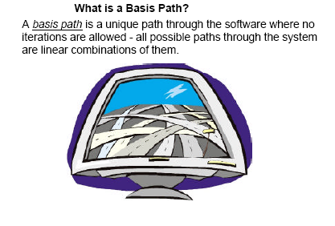
Basis Path Testing

Slide 19
McCabe’s Basis Path Testing
1: Draw a control flow graph
2: Calculate Cyclomatic complexity
3: Choose a “basis set” of paths
4: Generate test cases to exercise each path

Slide 20
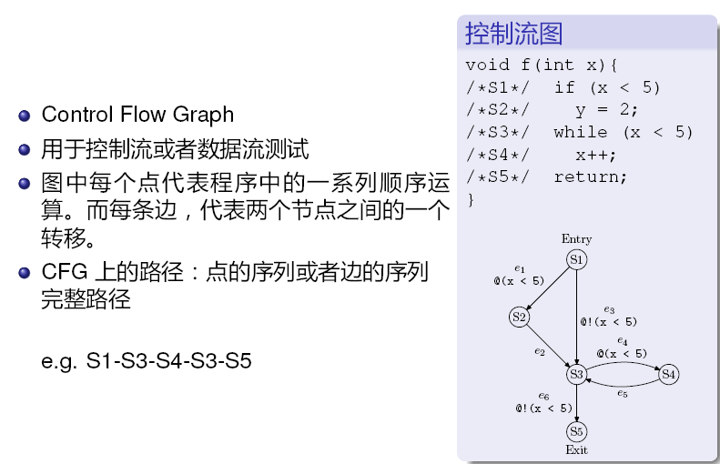
Control Flow Graph

Slide 21
Control-flow Graph
p_{i}={s1, s3, s4, s3, s5}
p_{i}=[x_{i1}, x_{i2}, x_{i3}, … x_{in}]
p_{i}=[1,0,2,1,1]
V={p_{i}}是否构成了线性空间？
线性运算的封闭

Slide 22
How ?

Slide 23
Matrix
每行一个path, 列为对应path执行statement or branch的次数.
[x₁₁, x₁₂, x₁₃, … x_{1n}]
[x₂₁, x₂₂, x₂₃, … x_{2n}]
[x₃₁, x₃₂, x₃₃, … x_{3n}]
[………………….]
记组成的矩阵为M，path数量无穷，所以M的行数可以无穷。
rank(M)的上界为多少？
rank(M)=？

Slide 24
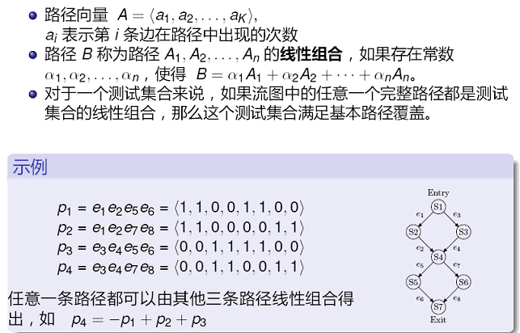
Basis Path Testing

Slide 25
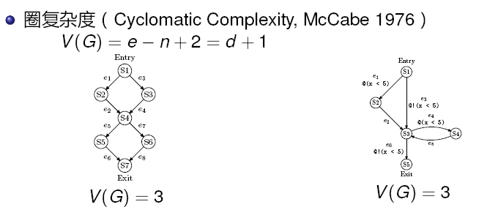
Cyclomatic Complexity

Slide 26
Theoretical Results
若CFG中的所有路径都是可行的，则存在V(G)条线性独立的完整路径，且其它路径可由这些路径线性表示。
若CFG中的存在不可行的路径，那么判断程序是否存在V(G)条基本路径是不可判定的。
Path Testing>=BPT>=Branch Testing

Slide 27
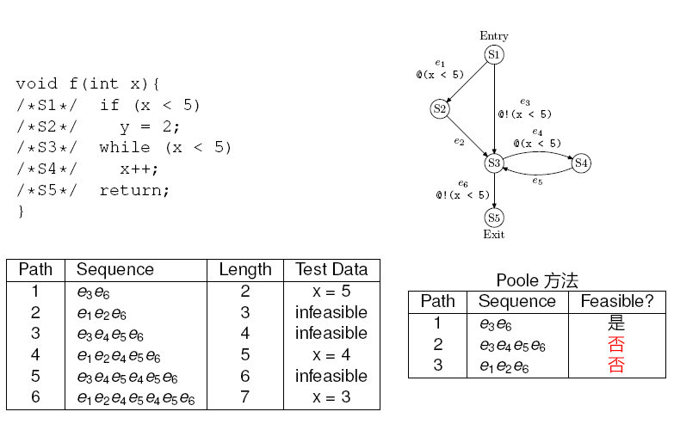
Generate Test Case

Slide 28
Basis Path Testing Process
Step 1 : Using the design or code as a foundation, draw a corresponding flow graph.
Step 2: Determine the cyclomatic complexity of the resultant flow graph.
Step 3: Determine a basis set of linearly independent paths.
Step 4: Prepare test cases that will force execution of each path in the basis set.

Slide 29
Data Flow Coverage for Source
def : a location where a value is stored into memory
  x appears on the left side of an assignment (x = 44;)
  x is an actual parameter in a call and the method changes its value
  x is a formal parameter of a method (implicit def when method starts)
  x is an input to a program
use : a location where variable’s value is accessed
  x appears on the right side of an assignment
  x appears in a conditional test
  x is an actual parameter to a method
  x is an output of the program
  x is an output of a method in a return statement
If a def and a use appear on the same node, then it is only a DU-pair if the def occurs after the use and the node is in a loop

Slide 30
Example Data Flow – Stats
public static void computeStats (int [ ] numbers)
{
int length = numbers.length;
double med, var, sd, mean, sum, varsum;
sum = 0.0;
for (int i = 0; i < length; i++)
{
sum += numbers [ i ];
}
med = numbers [ length / 2 ];
mean = sum / (double) length;
varsum = 0.o;
for (int i = 0; i < length; i++)
{
varsum = varsum + ((numbers [ i ] - mean) * (numbers [ i ] - mean));
}
var = varsum / ( length - 1 );
sd = Math.sqrt ( var );
System.out.println ("length: " + length);
System.out.println ("mean: " + mean);
System.out.println ("median: " + med);
System.out.println ("variance: " + var);
System.out.println ("standard deviation: " + sd);
}

Slide 31
CFG for Stats – With Defs & Uses
1
def (1) = { numbers, sum, length }
2
def (2) = { i }
3
use (3, 5) = { i, length }
use (3, 4) = { i, length }
4
5
def (5) = { med, mean, varsum, i }
use (5) = { numbers, length, sum }
def (4) = { sum, i }
use (4) = { sum, numbers, i }
6
use (6, 8) = { i, length }
use (6, 7) = { i, length }
def (8) = { var, sd }
use (8) = { varsum, length, mean,
med, var, sd }
7
8
def (7) = { varsum, i }
use (7) = { varsum, numbers, i, mean }

Slide 32
Defs and Uses Tables for Stats
Node | Def | Use
1 | { numbers, sum, length } | { numbers }
2 | { i }
3
4 | { sum, i } | { numbers, i, sum }
5 | { med, mean, varsum, i } | { numbers, length, sum }
6
7 | { varsum, i } | { varsum, numbers, i, mean }
8 | { var, sd } | { varsum, length, var, mean, med, var, sd }
Edge | Use
(1, 2)
(2, 3)
(3, 4) | { i, length }
(4, 3)
(3, 5) | { i, length }
(5, 6)
(6, 7) | { i, length }
(7, 6)
(6, 8) | { i, length }

Slide 33
Data Flow Criteria
Goal: Try to ensure that values are computed and used correctly
Definition (def) : A location where a value for a variable is stored into memory
Use : A location where a variable’s value is accessed
def (n) or def (e) : The set of variables that are defined by node n or edge e
use (n) or use (e) : The set of variables that are used by node n or edge e
Z = X*2
Defs: def (0) = {X}
def (4) = {Z}
def (5) = {Z}
Uses: use (4) = {X}
use (5) = {X}
1
4
X = 42
0
3
6
2
5
Z = X-8

Slide 34
DU Pairs and DU Paths
DU pair : A pair of locations (l_{i}, l_{j}) such that a variable v is defined at l_{i} and used at l_{j}
Def-clear : A path from l_{i} to l_{j} is def-clear with respect to variable v if v is not given another value on any of the nodes or edges in the path
Reach : If there is a def-clear path from l_{i} to l_{j} with respect to v, the def of v at l_{i} reaches the use at l_{j}
du-path : A simple subpath that is def-clear with respect to v from a def of v to a use of v
du (n_{i}, n_{j}, v) – the set of du-paths from n_{i} to n_{j}
du (n_{i}, v) – the set of du-paths that start at n_{i}

Slide 35
Data Flow Test Criteria
First, we make sure every def reaches a use
All-defs coverage (ADC) : For each set of du-paths S = du (n, v), TR contains at least one path d in S.
Then we make sure that every def reaches all possible uses
All-uses coverage (AUC) : For each set of du-paths to uses S = du (n_{i}, n_{j}, v), TR contains at least one path d in S.
Finally, we cover all the paths between defs and uses
All-du-paths coverage (ADUPC) : For each set S = du (ni, nj, v), TR contains every path d in S.

Slide 36
Data Flow Testing Example
Z = X*2
1
4
X = 42
0
3
6
2
5
Z = X-8
All-defs for X
[ 0, 1, 3, 4 ]
All-uses for X
[ 0, 1, 3, 4 ]
[ 0, 1, 3, 5 ]
All-du-paths for X
[ 0, 1, 3, 4 ]
[ 0, 2, 3, 4 ]
[ 0, 1, 3, 5 ]
[ 0, 2, 3, 5 ]

Slide 37
Example Control Flow – Stats
public static void computeStats (int [ ] numbers)
{
int length = numbers.length;
double med, var, sd, mean, sum, varsum;
sum = 0;
for (int i = 0; i < length; i++)
{
sum += numbers [ i ];
}
med = numbers [ length / 2];
mean = sum / (double) length;
varsum = 0;
for (int i = 0; i < length; i++)
{
varsum = varsum + ((numbers [ I ] - mean) * (numbers [ I ] - mean));
}
var = varsum / ( length - 1.0 );
sd = Math.sqrt ( var );
System.out.println ("length: " + length);
System.out.println ("mean: " + mean);
System.out.println ("median: " + med);
System.out.println ("variance: " + var);
System.out.println ("standard deviation: " + sd);
}
© Ammann & Offutt

Slide 38
CFG for Stats – With Defs & Uses
1
def (1) = { numbers, sum, length }
2
def (2) = { i }
3
use (3, 5) = { i, length }
use (3, 4) = { i, length }
4
5
def (5) = { med, mean, varsum, i }
use (5) = { numbers, length, sum }
def (4) = { sum, i }
use (4) = { sum, numbers, i }
6
use (6, 8) = { i, length }
use (6, 7) = { i, length }
def (8) = { var, sd }
use (8) = { varsum, length, mean,
med, var, sd }
7
8
def (7) = { varsum, i }
use (7) = { varsum, numbers, i, mean }

Slide 39
DU Pairs for Stats
defs come before uses, do not count as DU pairs
variable | DU Pairs
numbers | (1, 4) (1, 5) (1, 7)
length | (1, 5) (1, 8) (1, (3,4)) (1, (3,5)) (1, (6,7)) (1, (6,8))
med | (5, 8)
var | (8, 8)
sd | (8, 8)
mean | (5, 7) (5, 8)
sum | (1, 4) (1, 5) (4, 4) (4, 5)
varsum | (5, 7) (5, 8) (7, 7) (7, 8)
i | (2, 4) (2, (3,4)) (2, (3,5)) (2, 7) (2, (6,7)) (2, (6,8)) (4, 4) (4, (3,4)) (4, (3,5)) (4, 7) (4, (6,7)) (4, (6,8)) (5, 7) (5, (6,7)) (5, (6,8)) (7, 7) (7, (6,7)) (7, (6,8))
defs after use in loop, these are valid DU pairs
No def-clear path …
different scope for i
No path through graph from nodes 5 and 7 to 4 or 3

Slide 40
DU Paths for Stats
variable | DU Pairs | DU Paths
numbers | (1, 4) (1, 5) (1, 7) | [ 1, 2, 3, 4 ] [ 1, 2, 3, 5 ] [ 1, 2, 3, 5, 6, 7 ]
length | (1, 5) (1, 8) (1, (3,4)) (1, (3,5)) (1, (6,7)) (1, (6,8)) | [ 1, 2, 3, 5 ] [ 1, 2, 3, 5, 6, 8 ] [ 1, 2, 3, 4 ] [ 1, 2, 3, 5 ] [ 1, 2, 3, 5, 6, 7 ] [ 1, 2, 3, 5, 6, 8 ]
med | (5, 8) | [ 5, 6, 8 ]
var | (8, 8) | No path needed
sd | (8, 8) | No path needed
sum | (1, 4) (1, 5) (4, 4) (4, 5) | [ 1, 2, 3, 4 ] [ 1, 2, 3, 5 ] [ 4, 3, 4 ] [ 4, 3, 5 ]
variable | DU Pairs | DU Paths
mean | (5, 7) (5, 8) | [ 5, 6, 7 ] [ 5, 6, 8 ]
varsum | (5, 7) (5, 8) (7, 7) (7, 8) | [ 5, 6, 7 ] [ 5, 6, 8 ] [ 7, 6, 7 ] [ 7, 6, 8 ]
i | (2, 4) (2, (3,4)) (2, (3,5)) (4, 4) (4, (3,4)) (4, (3,5)) (5, 7) (5, (6,7)) (5, (6,8)) (7, 7) (7, (6,7)) (7, (6,8)) | [ 2, 3, 4 ] [ 2, 3, 4 ] [ 2, 3, 5 ] [ 4, 3, 4 ] [ 4, 3, 4 ] [ 4, 3, 5 ] [ 5, 6, 7 ] [ 5, 6, 7 ] [ 5, 6, 8 ] [ 7, 6, 7 ] [ 7, 6, 7 ] [ 7, 6, 8 ]

Slide 41
DU Paths for Stats – No Duplicates
There are 38 DU paths for Stats, but only 12 unique
[ 1, 2, 3, 4 ]
[ 1, 2, 3, 5 ]
[ 1, 2, 3, 5, 6, 7 ]
[ 1, 2, 3, 5, 6, 8 ]
[ 2, 3, 4 ]
[ 2, 3, 5 ]
[ 4, 3, 4 ]
[ 4, 3, 5 ]
[ 5, 6, 7 ]
[ 5, 6, 8 ]
[ 7, 6, 7 ]
[ 7, 6, 8 ]
4 expect a loop not to be “entered”
6 require at least one iteration of a loop
2 require at least two iterations of a loop

Slide 42
Example Data Flow – Stats
public static void computeStats (int [ ] numbers)
{
int length = numbers.length;
double med, var, sd, mean, sum, varsum;
sum = 0.0;
for (int i = 0; i < length; i++)
{
sum += numbers [ i ];
}
med = numbers [ length / 2 ];
mean = sum / (double) length;
varsum = 0.o;
for (int i = 0; i < length; i++)
{
varsum = varsum + ((numbers [ i ] - mean) * (numbers [ i ] - mean));
}
var = varsum / ( length - 1 );
sd = Math.sqrt ( var );
System.out.println ("length: " + length);
System.out.println ("mean: " + mean);
System.out.println ("median: " + med);
System.out.println ("variance: " + var);
System.out.println ("standard deviation: " + sd);
}

Slide 43
Test Cases and Test Paths
Test Case : numbers = (44) ; length = 1
Test Path : [ 1, 2, 3, 4, 3, 5, 6, 7, 6, 8 ]
Additional DU Paths covered (no sidetrips)
[ 1, 2, 3, 4 ] [ 2, 3, 4 ] [ 4, 3, 5 ] [ 5, 6, 7 ] [ 7, 6, 8 ]
The five stars that require at least one iteration of a loop
Test Case : numbers = (2, 10, 15) ; length = 3
Test Path : [ 1, 2, 3, 4, 3, 4, 3, 4, 3, 5, 6, 7, 6, 7, 6, 7, 6, 8 ]
DU Paths covered (no sidetrips)
[ 4, 3, 4 ] [ 7, 6, 7 ]
The two stars that require at least two iterations of a loop
Other DU paths require arrays with length 0 to skip loops
But the method fails with index out of bounds exception…
med = numbers [length / 2];
A fault was
found

Slide 44
Summary
Applying the graph test criteria to control flow graphs is relatively straightforward
  Most of the developmental research work was done with CFGs
A few subtle decisions must be made to translate control structures into the graph
Some tools will assign each statement to a unique node
  These slides and the book uses basic blocks
  Coverage is the same, although the bookkeeping will differ

Slide 45

Q & A

